Slide 1

Samsung RS85 Prestige測量FF的準確度
Report 2026/1/11

Slide 2
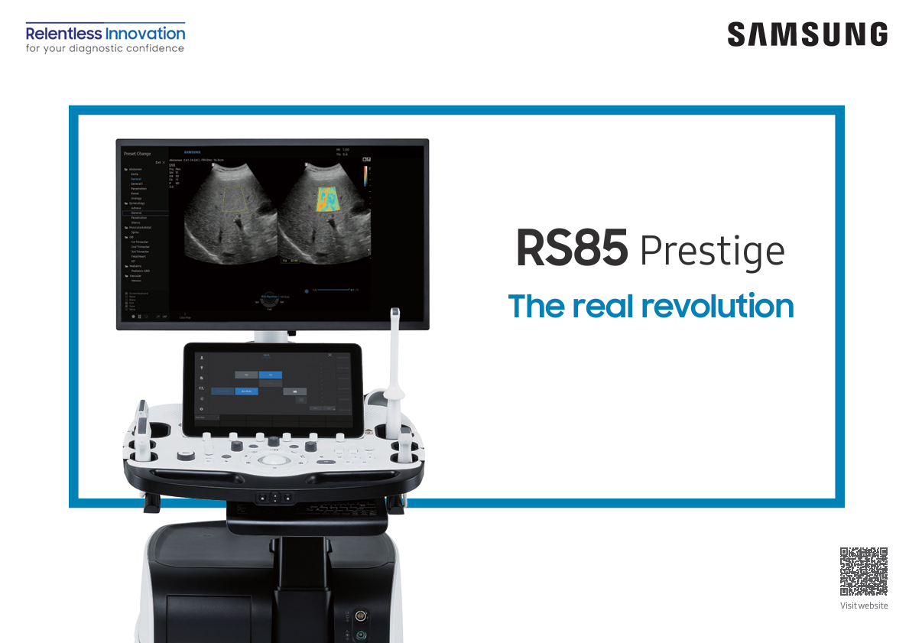
Samsung 超音波機器(醫院目前用的)
RS85 Prestige – 2020/01
RS85 Prestige v2.08 - Catalog - CE – 2024/01/31

Slide 3
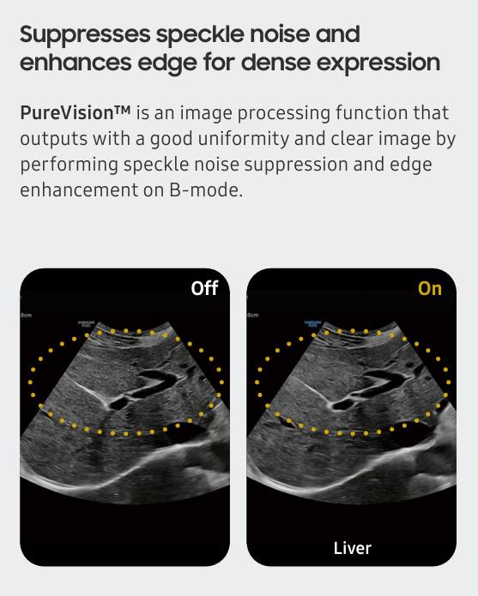
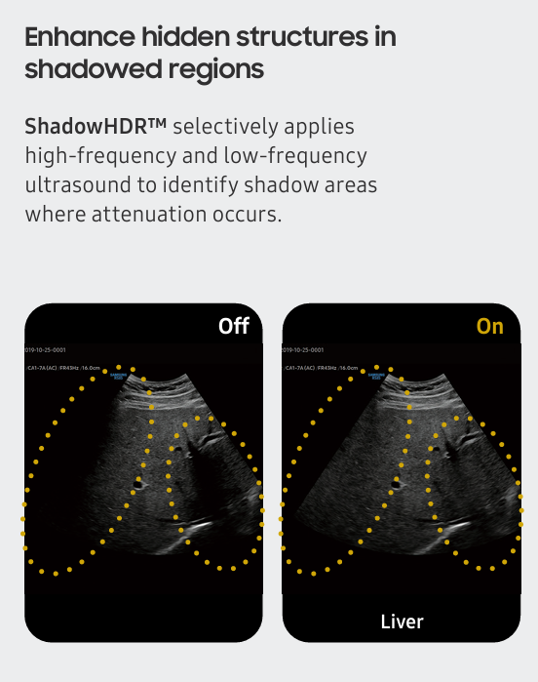
改進和測量不同影像的方法

Slide 4
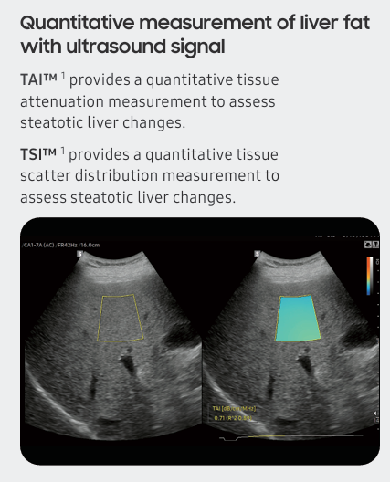
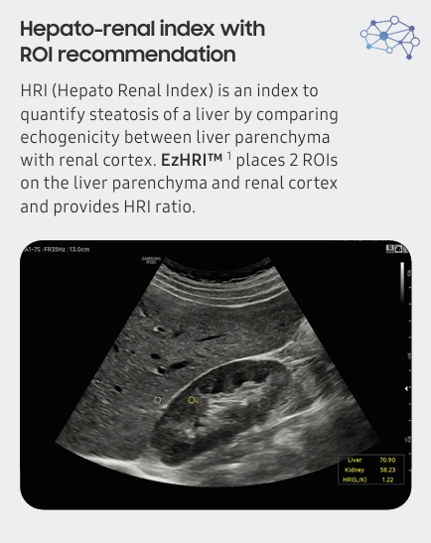
改進和測量不同影像的方法

Slide 5
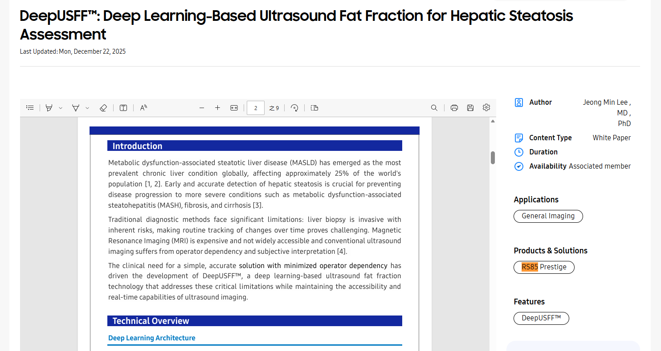
DeepUSFF™
三星Rs85機器的白皮書: Deep Learning-Based Ultrasound Fat Fraction for Hepatic Steatosis Assessment

Slide 6
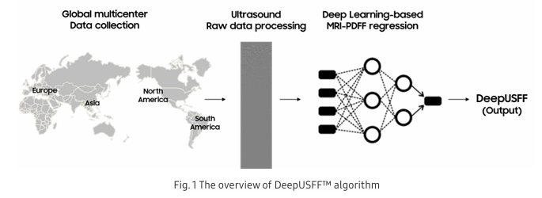
DeepUSFF™
資料來源: 全球
使用的input data: raw frequency data

Slide 7
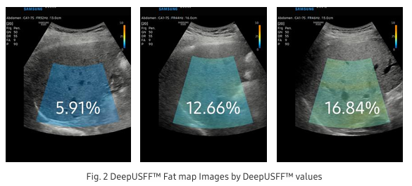
DeepUSFF™
For each frozen frame, DeepUSFF™ analyzes all liver-related characteristics such as the liver parenchyma or surrounding structures (e.g., diaphragm).
By delivering real-time liver fat fraction quantification, DeepUSFF™ simplifies the clinical workflow, providing immediate results without the step of selecting a region of interest (ROI).
Furthermore, a reliability indicator helps users assess the acceptability of the view for measurement.

Slide 8
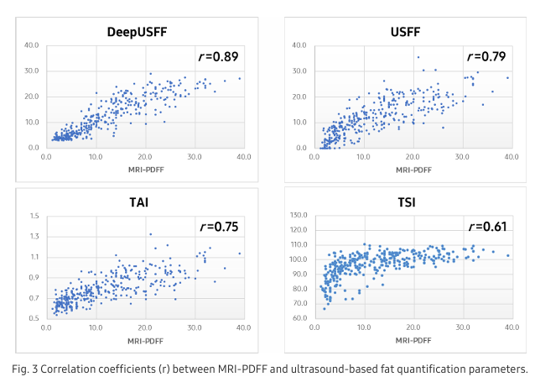
DeepUSFF™ performance
DeepUSFF™ had a correlation coefficient of r = 0.89 with MRI-PDFF outperformed existing ultrasound-based methods
The correlation coefficient of USFF (QUS-derived estimated fat fraction), TAI and with MRI-PDFF were 0.79, 0.75, and 0.61

Slide 9
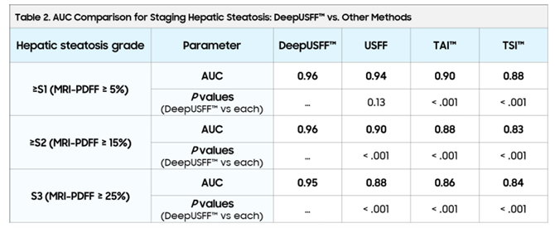
DeepUSFF™ performance
AUC比較:
DeepUSFF™
USFF(用TAI、TSI)
醫師肉眼判斷
得出前者較好(前者跟PDFF的差距較小)

Slide 10
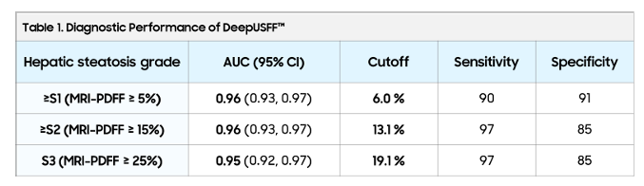
DeepUSFF™ performance
靈敏度、特異度比較:

Slide 11
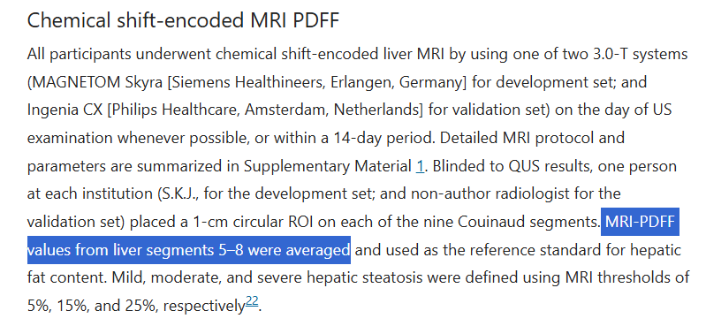
DeepUSFF™ MRI-PDFF
Reference文獻(Development and validation of multivariable quantitative ultrasound for diagnosing hepatic steatosis)中的方法和醫院的方法相同

Slide 12
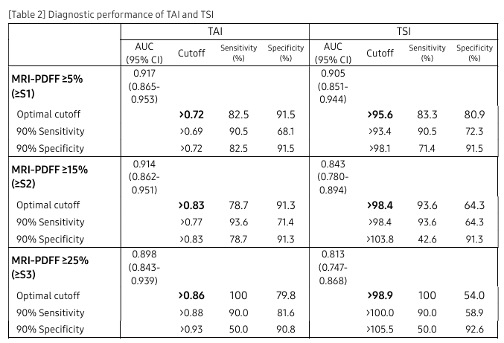
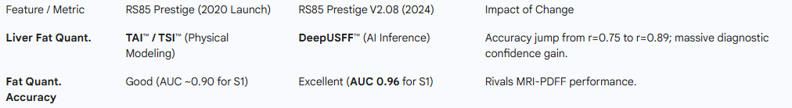
DeepUSFF™ earlier performance(2022)
https://21291849.fs1.hubspotusercontent-na1.net/hubfs/21291849/QUS%20Whitepaper.pdf

Slide 13
DeepUSFF™ earlier performance(2022)
與第一代相比

Slide 14
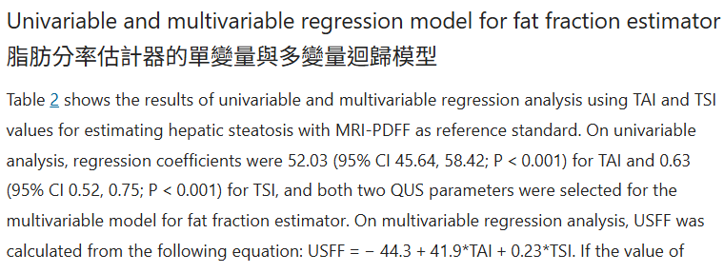
DeepUSFF™ earlier performance
文章中參考的paper - Development and validation of multivariable quantitative ultrasound for diagnosing hepatic steatosis
其中的USFF算法和醫院提供給我他們機器的算法一樣(USFF = -44.3 + 41.9*TAI + 0.23*TSI)

Slide 15
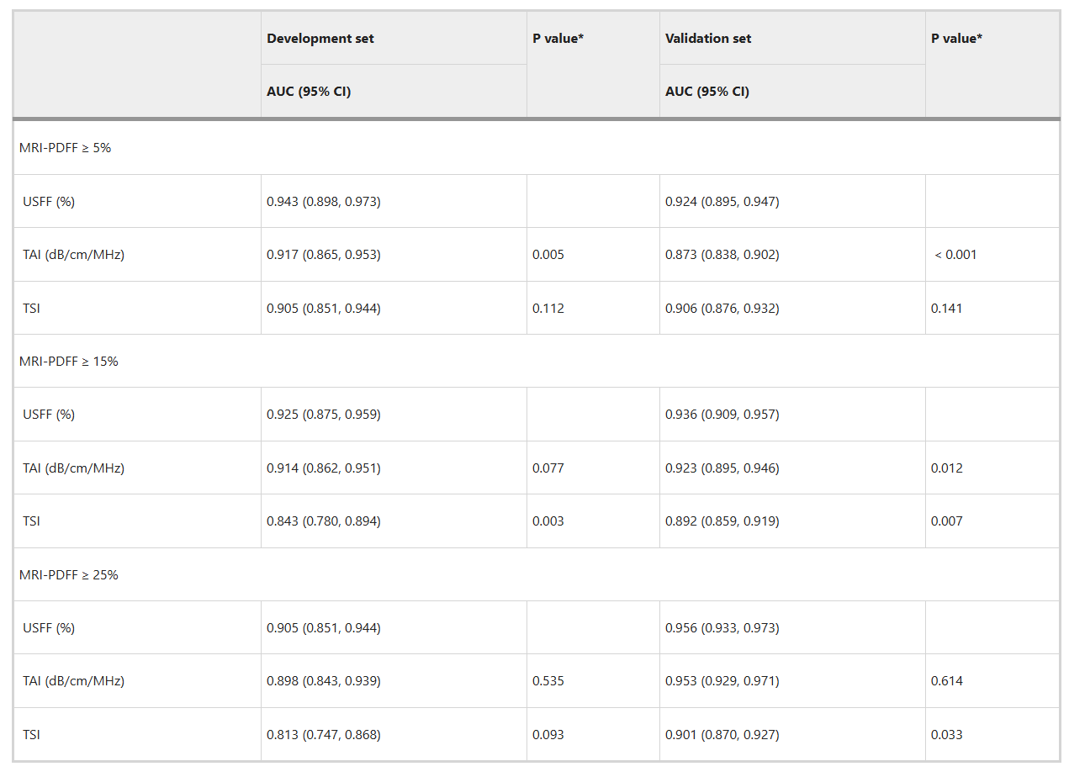
DeepUSFF™ earlier performance
文章中參考的paper - Development and validation of multivariable quantitative ultrasound for diagnosing hepatic steatosis
AUC

Slide 16
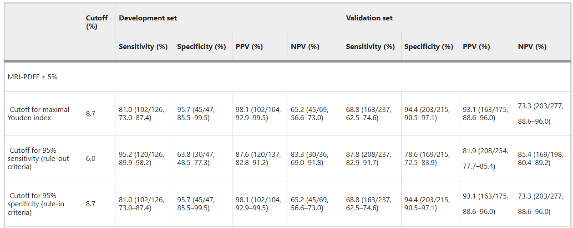
DeepUSFF™ earlier performance
文章中參考的paper - Development and validation of multivariable quantitative ultrasound for diagnosing hepatic steatosis
S1

Slide 17
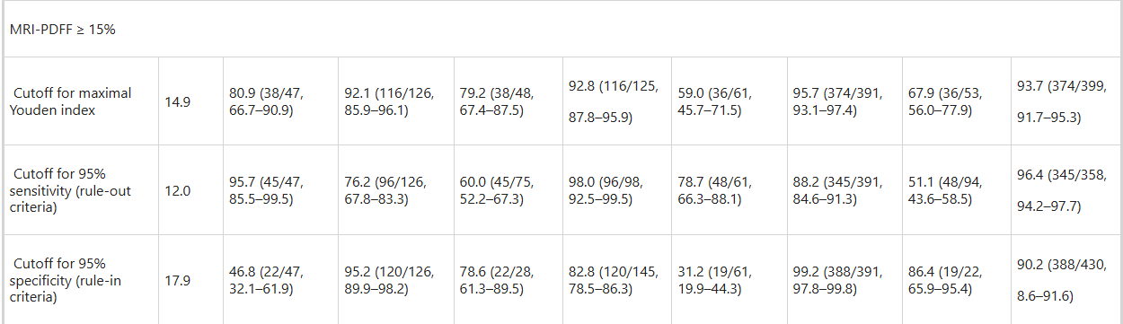
DeepUSFF™ earlier performance
文章中參考的paper - Development and validation of multivariable quantitative ultrasound for diagnosing hepatic steatosis
S2

Slide 18
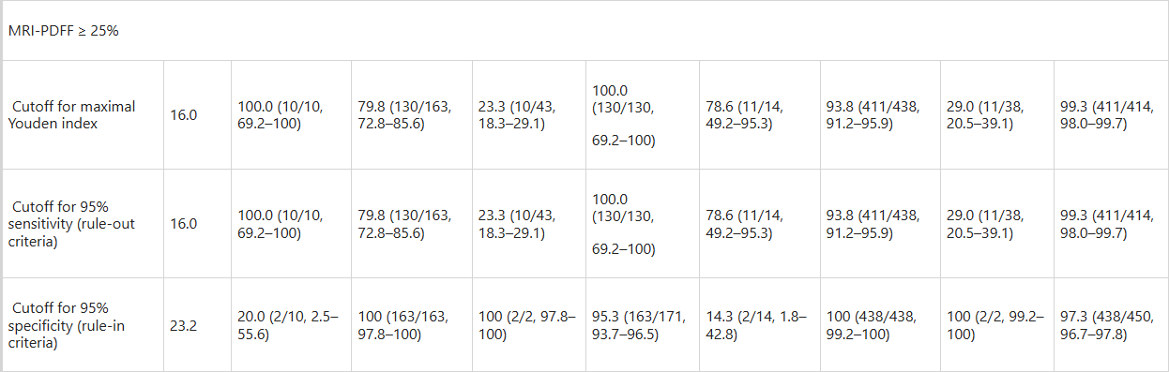
DeepUSFF™ earlier performance
文章中參考的paper - Development and validation of multivariable quantitative ultrasound for diagnosing hepatic steatosis
S3

Slide 19

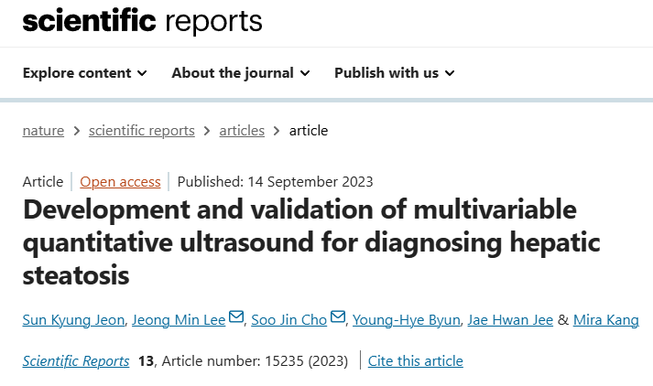
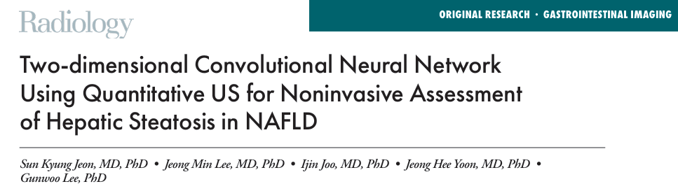
Samsung’s USFF development
Sensitive score
 | S1 | S2 | S3
First paper(val set) | 68.8 | 59.0 | 78.6
Second paper | 90 | 89 | 100

Slide 20
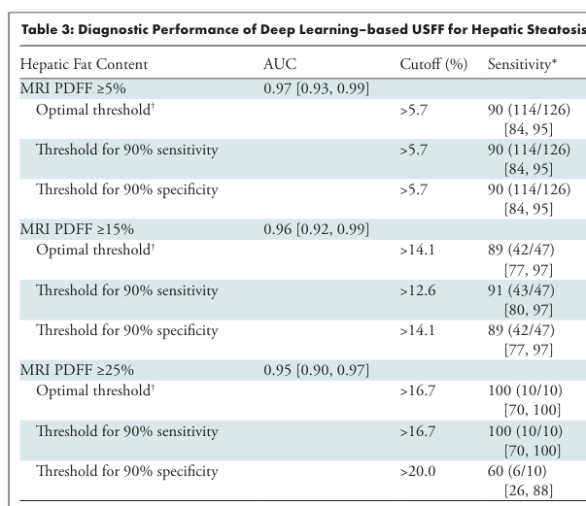
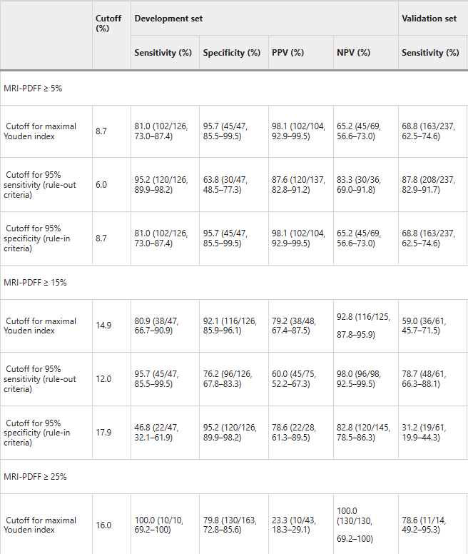
Samsung’s USFF development

Slide 21
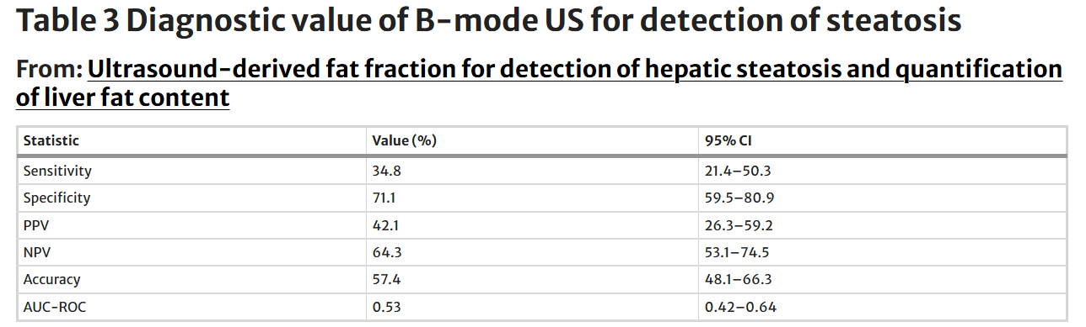
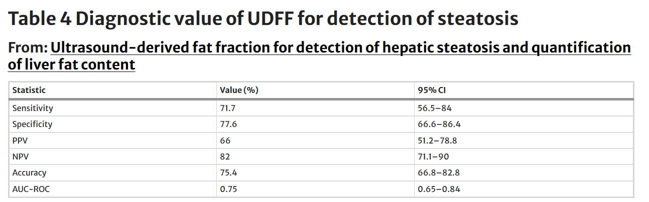
其他機器: ACUSON Sequoia(2018)
Ultrasound-derived fat fraction for detection of hepatic steatosis and quantification of liver fat content

